Slide 1
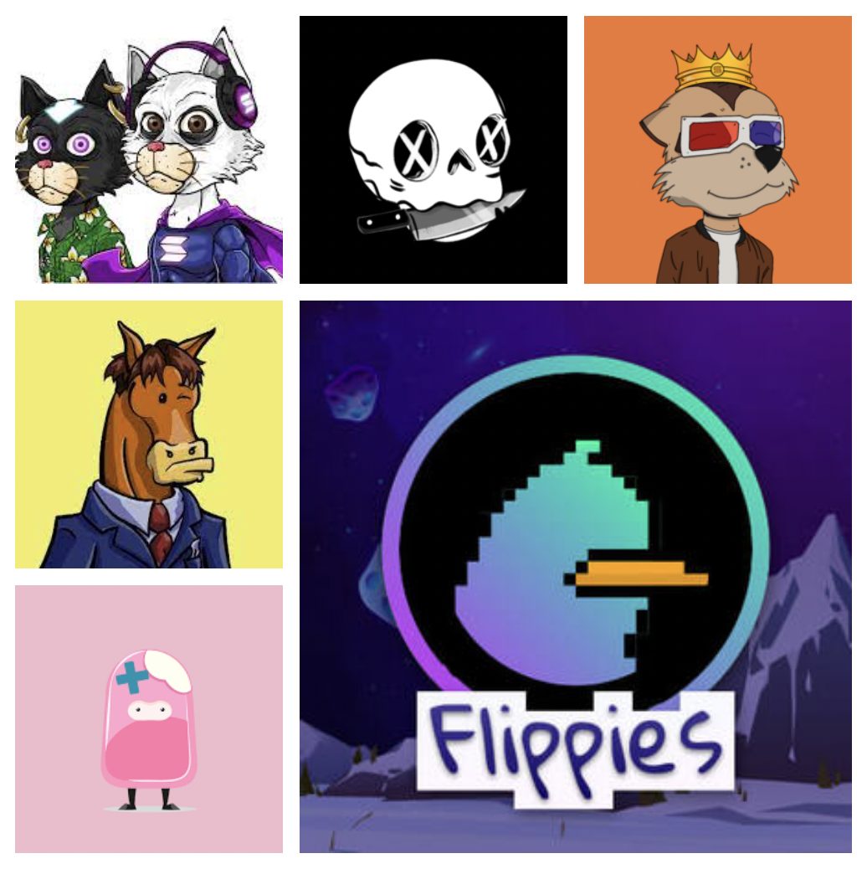
EXPLORATORY DATA ANALYSIS OF
SOLANA NFTs
Group 4
Syed Bilal Hussain
Damilola Olanrewaju
Dheekshith Kadavinahosahalli Malleshaiah
Parnit Kaur
Shreeya Suryakant Bidkar
Anantha Krishnan Santhosh

Slide 2
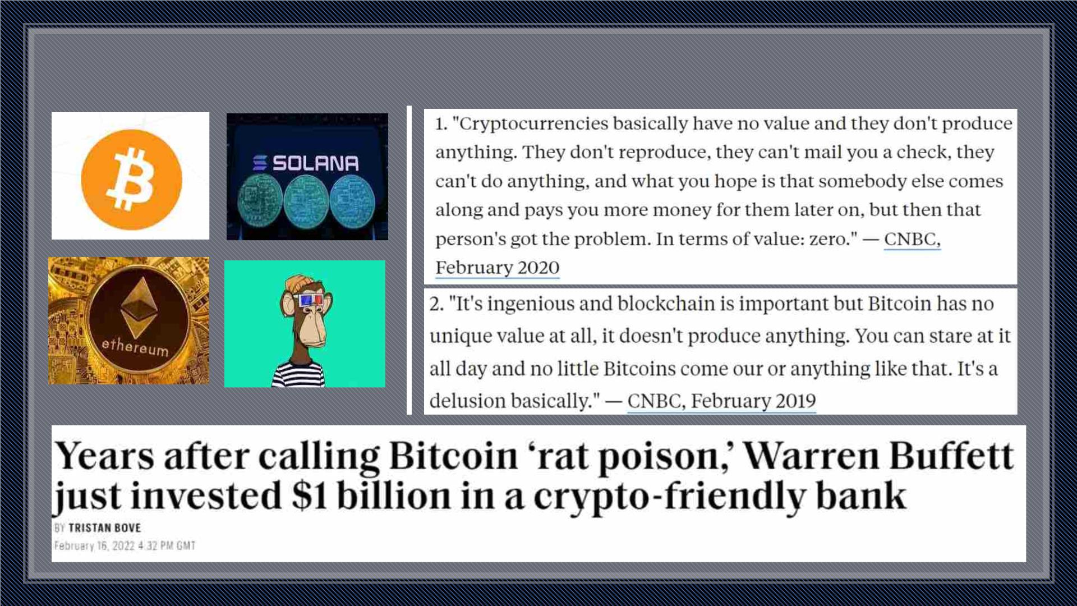
Introduction

Slide 3
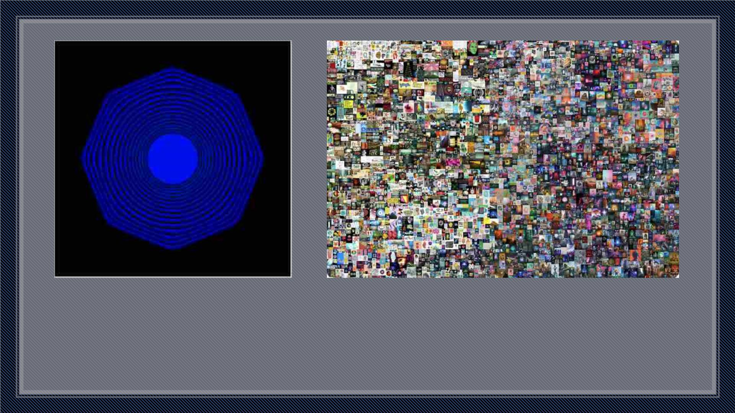
Kevin McCoys “quantum”,
the first ever NFT to be minted
Beeple’s “Everydays” was sold for $69.3 million
on March 2021.
NFT: A non-fungible token (NFT) is a non-interchangeable unit of data stored on a blockchain, a form of digital ledger,
that can be sold and traded.

Slide 4
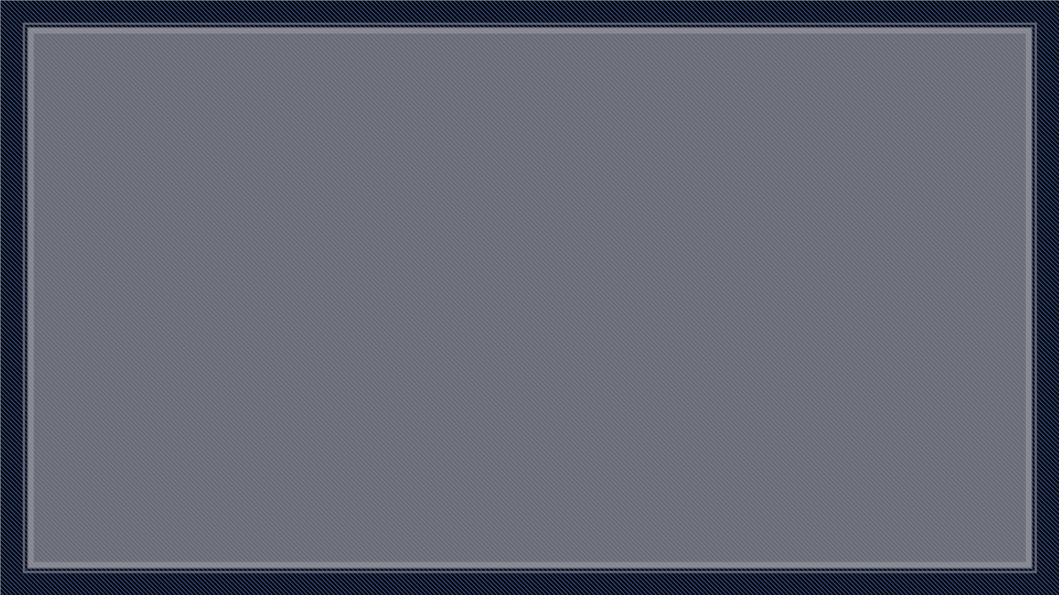
Why Solana?
• The Solana blockchain was created to solve the shortcomings of the Ethereum blockchain.
Solana was launched during the peak of the 2017 crypto surge. It has seen considerable growth,
jumping to the top 7 in market cap ($44+bn) in just its second year on the market In
September, as a ‘long-term rival’ of Ethereum.
• The main objective of the Solana Blockchain is to deliver on scalability without sacrificing
decentralization. Solana is one of the fastest blockchains in the crypto market.
• Solana's network processes a block every 2.34 seconds in contrast to Ethereum which sits at
around 15-transactions per second. Solana being almost 6 times faster than Ethereum
• Solana follows both proof of stake and proof of history mechanism, which is more efficient but
Ethereum follow proof of work has more decentralized network but less scalability.
• Solana is a high-performance decentralized blockchain built with the goal to enable the
scalability of user-friendly applications.
• Recently, OpenSea announced that Solana is now a supported blockchain on their Platform. It
means that Solana is a real competitor in the world for NFT.

Slide 5
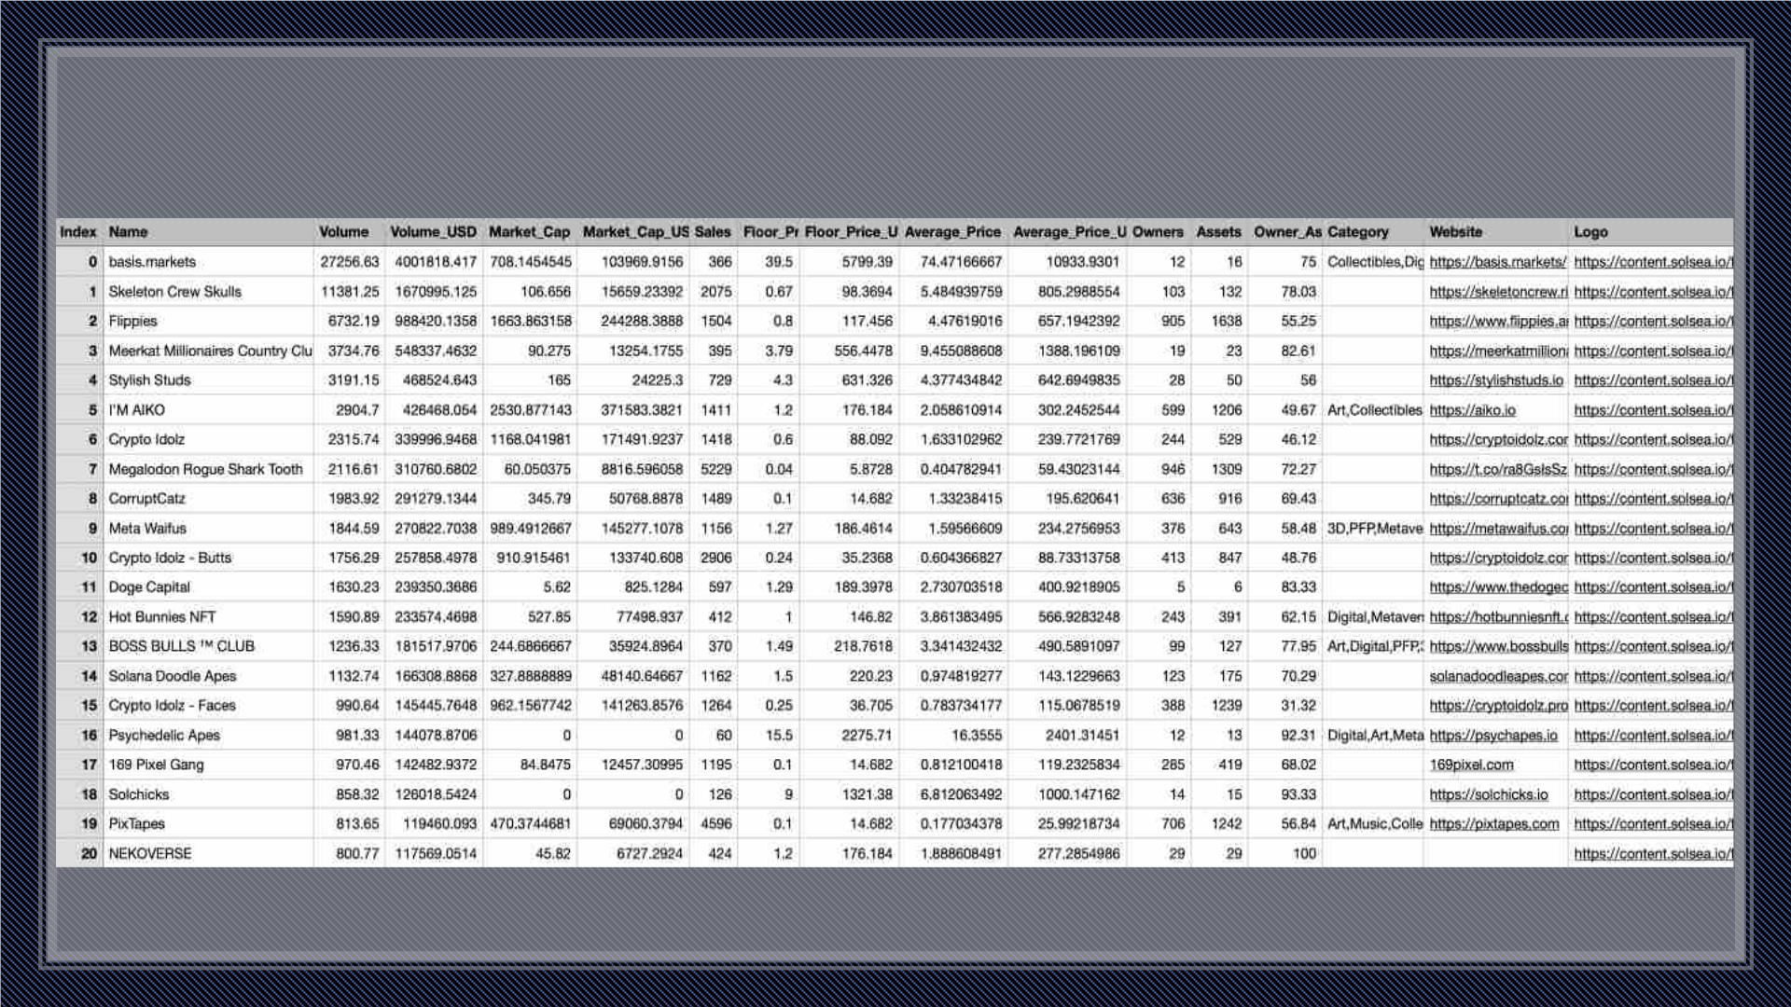
Data Collection

Slide 6
Data Collection
The dataset contains the following information on the NFT collections:
1. Index: The index of the file.
2. Name: The names of the NFT collections.
3. Volume: The total volume of sales from the NFT collection in Solana (SOL).
4. Volume_USD: The total volume of sales from the NFT collection in United States Dollar (USD).
5. Market Cap: The market capitalization, total value of the collection's items in circulation in
Solana (SOL).
6. Market_Cap_USD: The market capitalization USD, total value of the collection's items in
circulation in United States Dollar (USD).
7. Sales: The number of sales from the NFT collection.

Slide 7
Data Collection
8. Floor_Price: The lowest price at which any of the objects in the NFT collection were sold, in
Solana (SOL).
9. Floor_Price_USD: The lowest price at which any of the objects in the NFT collection were sold, in
United States Dollar (USD).
10.Average_Price: The average price of an NFT in the collection in Solana (SOL).
11. Average_Price_USD: The average price of an NFT in the collection in United States Dollar (USD).
12.Owners: The total number of owners of NFT's in the collection.
13.Assets: The number of objects in the collection.
14.Owner_Asset_Ratio: The ownership percentage of all the items in the collection.
15.Category: The category of the NFT collection.

Slide 8

Data Pre-processing
1
3
Dimensionality
Reduction
Import Data
Delete
Duplicates &
Missing Values
Manual
Import of
Categories
2
4

Slide 9
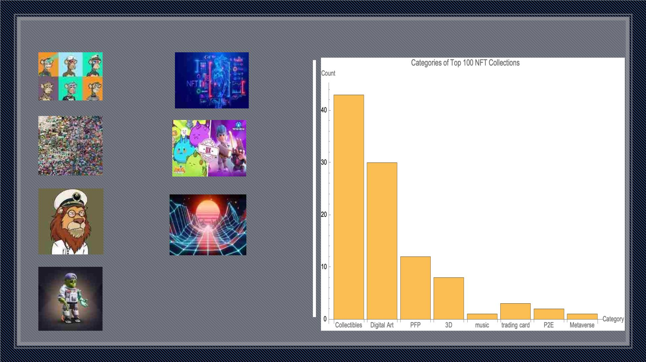
Categories
Collectible
Digital Art
Music
P2E
PFP
3D
Metaverse

Slide 10
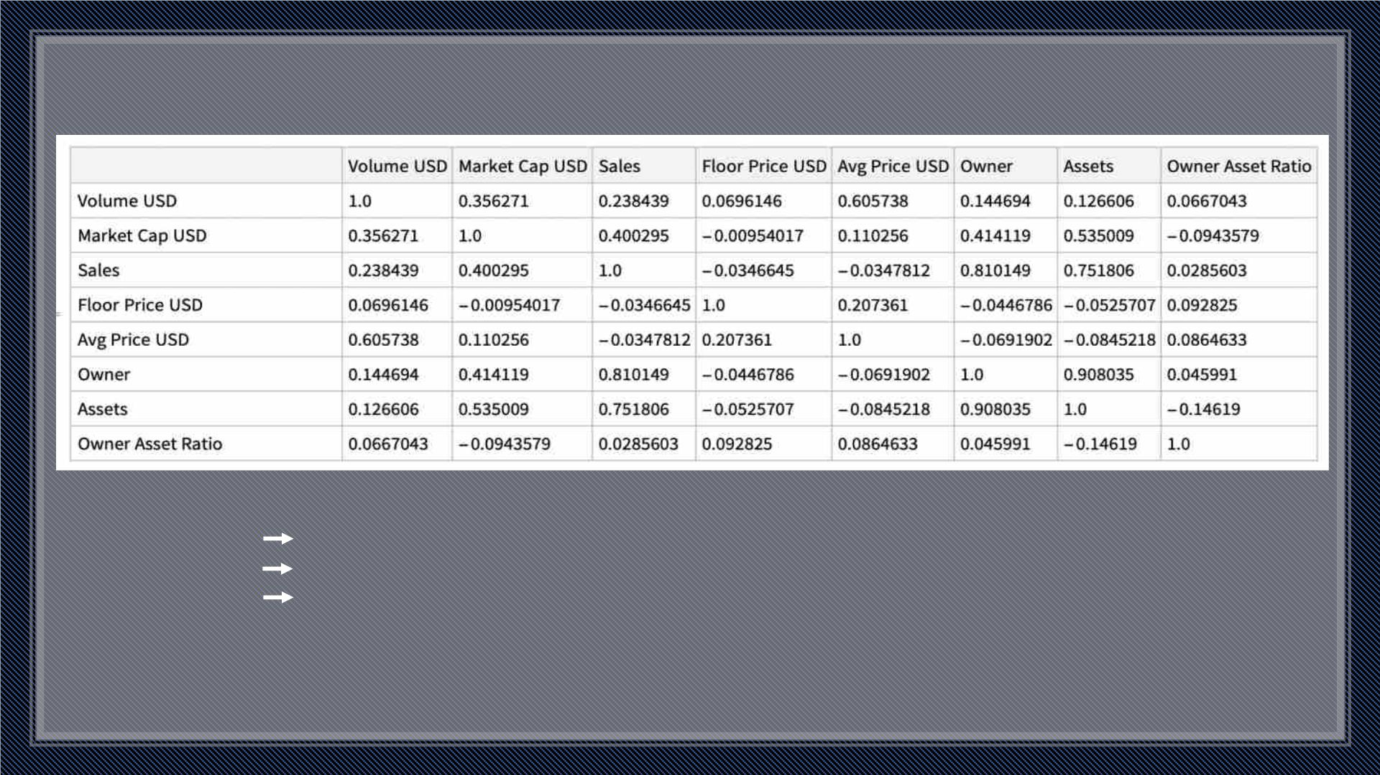
Correlation Analysis
Measure of relationship between the Columns
• 0 No relationship between variables
• 1 Perfect positive relationship between variables
• -1 Perfect negative relationship between variables
The correlation analysis was performed between Volume, Market Cap, Sales, Floor Price,
Average Price, Owners, Assets and Owner Asset Ratio.

Slide 11
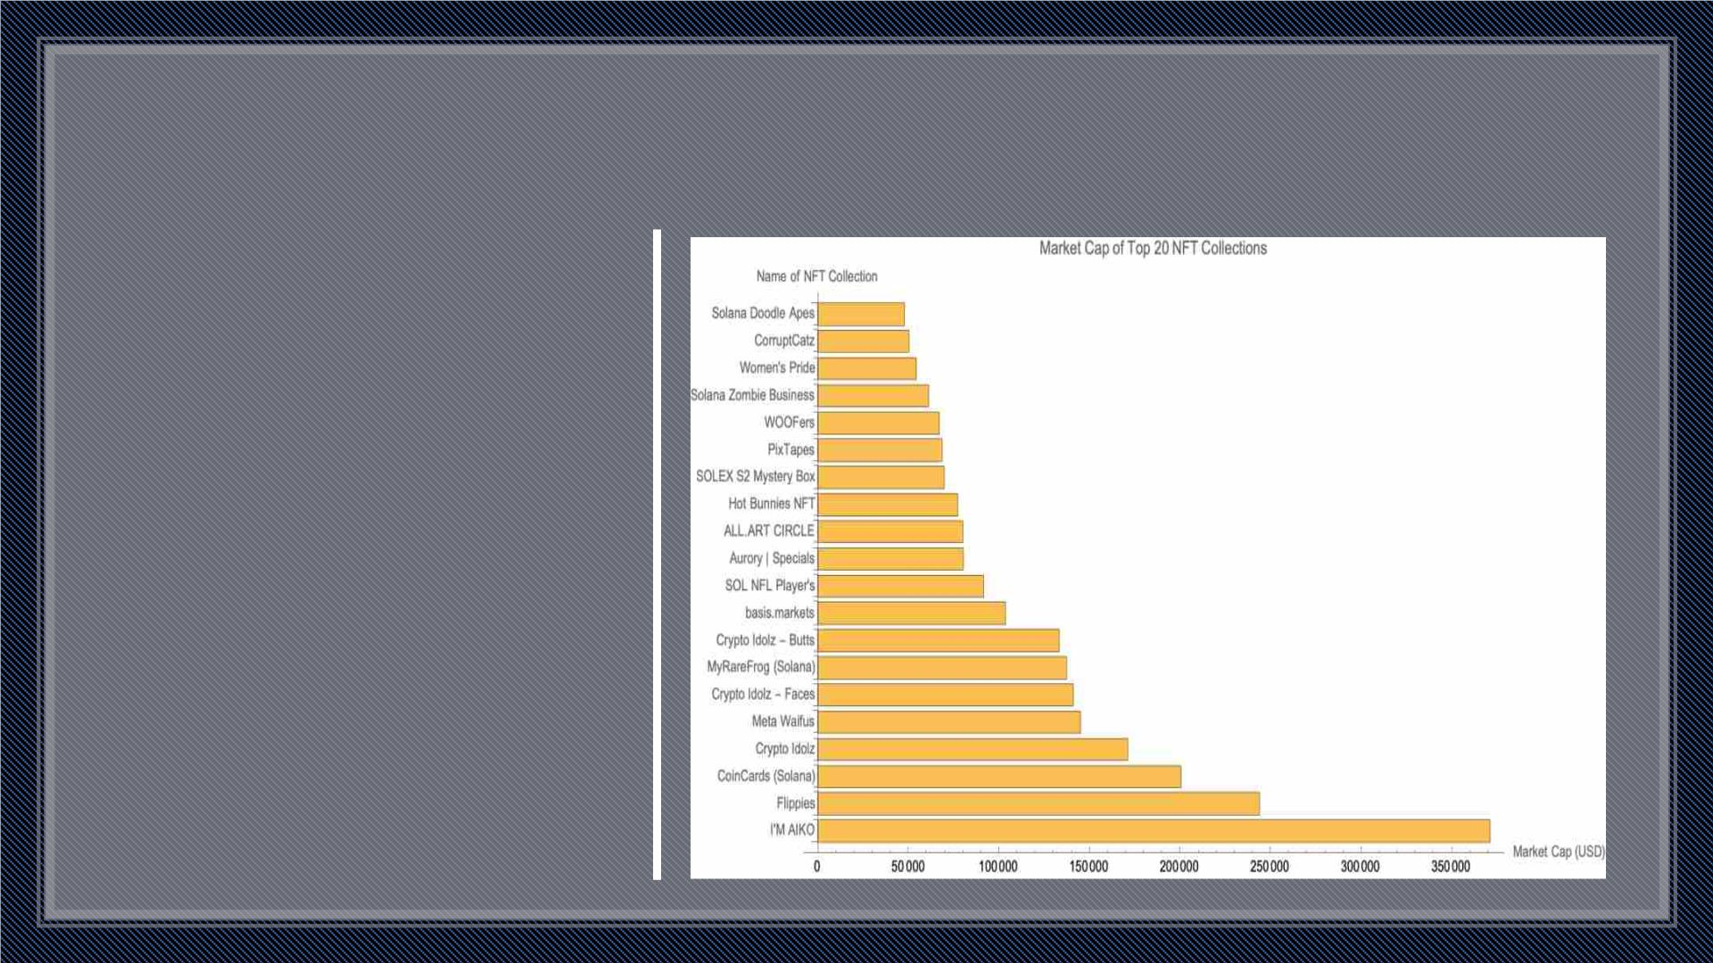
Top 20 NFT Collections based on Market Capital
• Market Capital – The market
value of a publicly traded
company’s outstanding shares.
• 3/5th of the Market Cap was
held by 20 NFT Collection.
• Among the top 5 collections,
three of them are NSFW:
- Price Range: $200-$300
- Market Cap Range: $150k - $370k

Slide 12
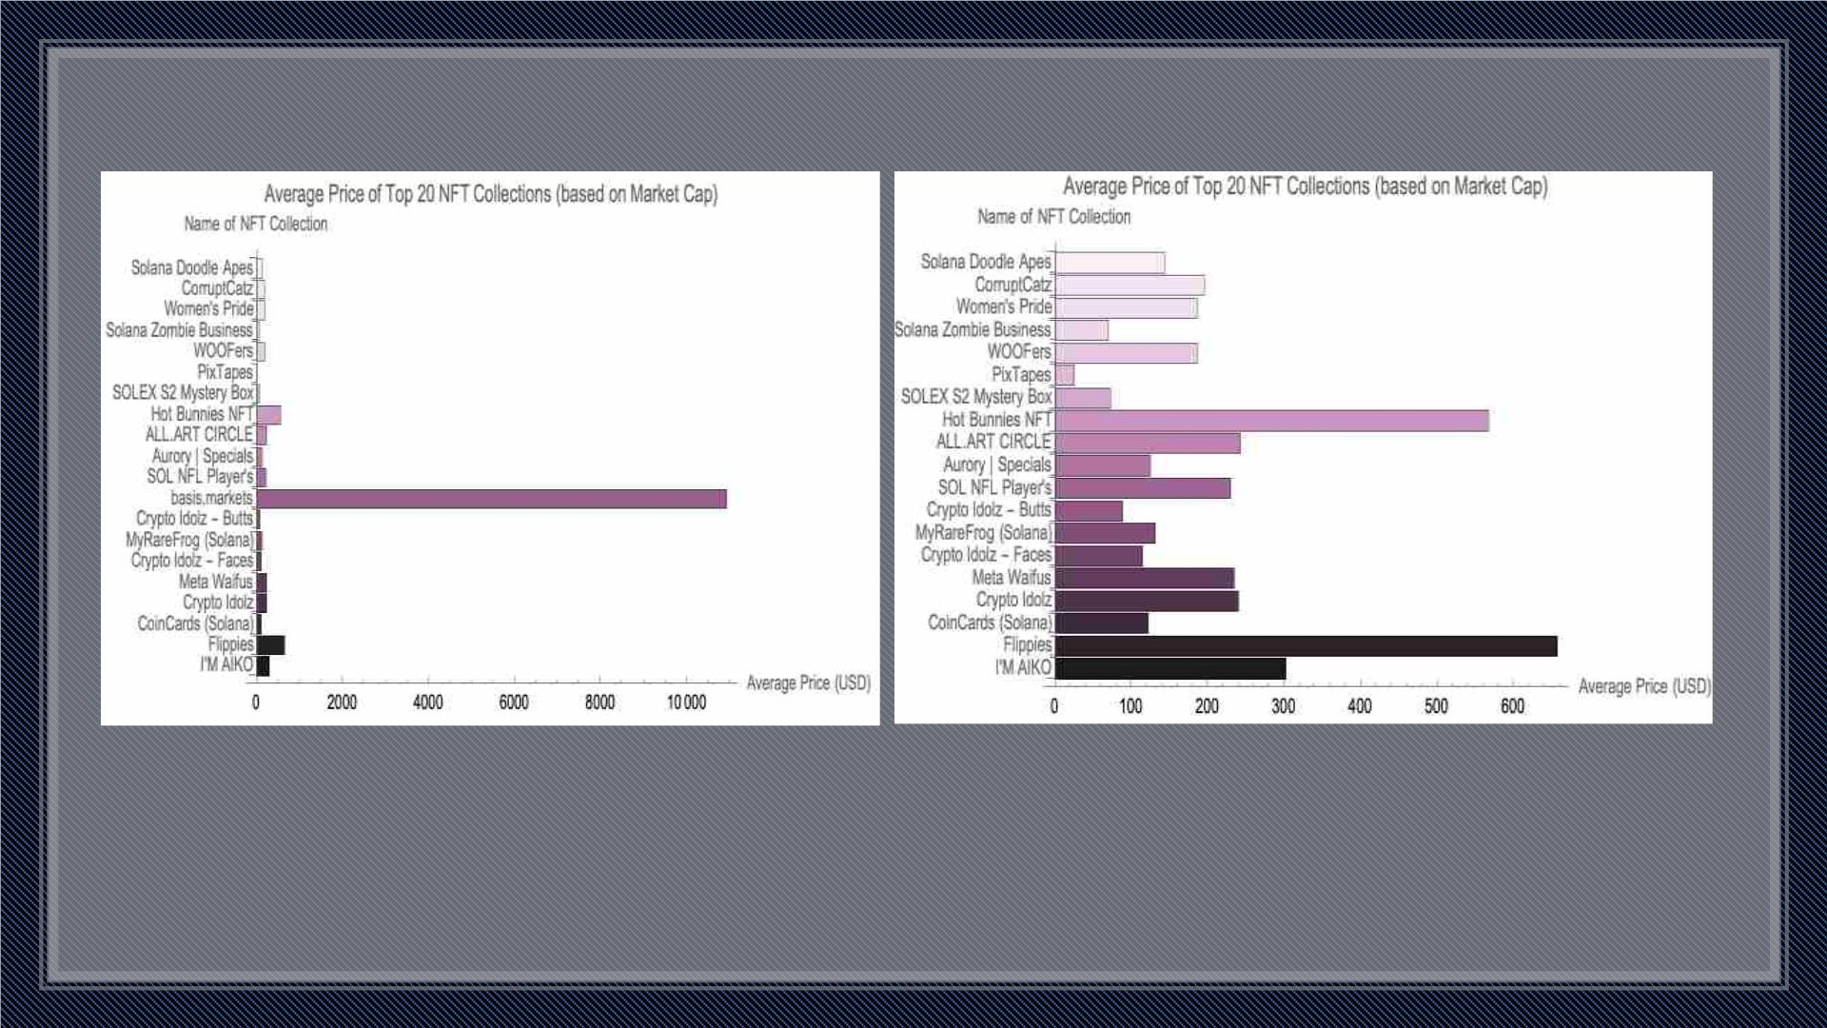
Continued
• ‘Basis.markets’ NFT have the highest average price, that is $10933.9, followed by ‘Flippies’ and ‘Hot Bunnies’
• PixTapes being the cheapest, $26.
• Overall average price around $207

Slide 13
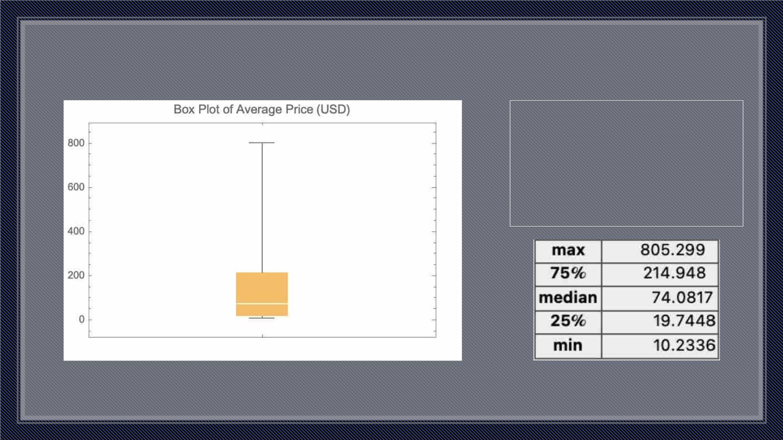
Top 20 NFT Collections based on Sales
Held 42.17% of the overall sales
Evaluating average prices
- Maximum: $805.299
- Minimum: $10.2336

Slide 14
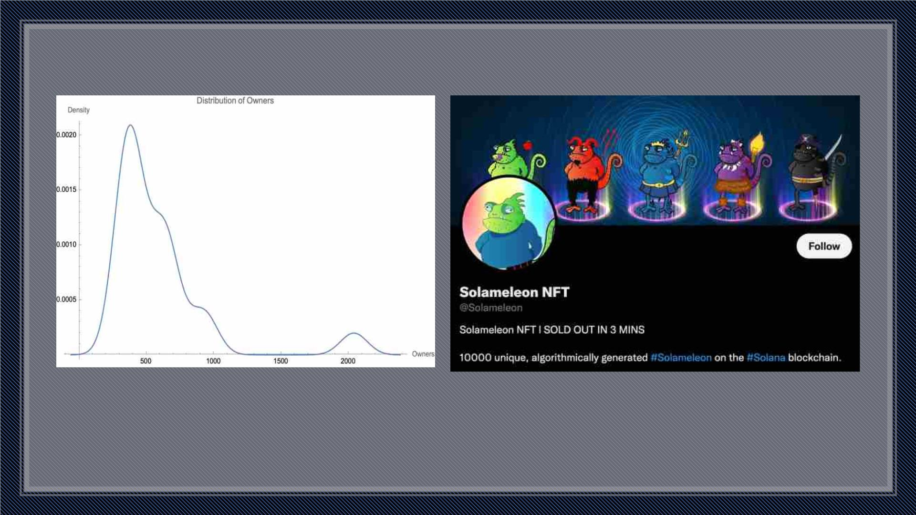
Top 20 NFT Collections based on Owners
Contributes about 12% [128,267] of the total number of owners
- ‘Solameleon’ NFT:
- has the highest number of owners, constituting approx. 2% of the total owners
- has the second highest number of sales (previously observed)
- with the above two unique factors, making it obvious to be the most popular NFT

Slide 15
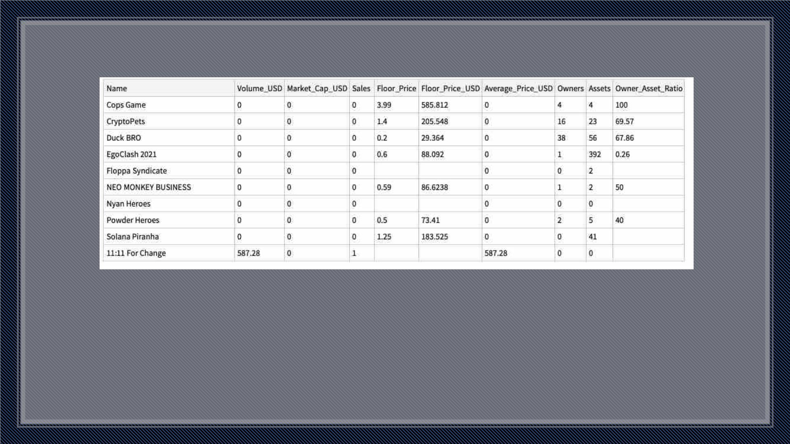
Failed NFTs
Assumptions:
Result:
• If Market Cap is 0 => Failed Project
Out of 600 NFT Collections
• 9 were complete failures (1.5%)
• 311 were failed projects (52.5%)
• If Market Cap as well as Sales are 0 => Complete Failure
Over half of the NFT projects failed!!

Slide 16
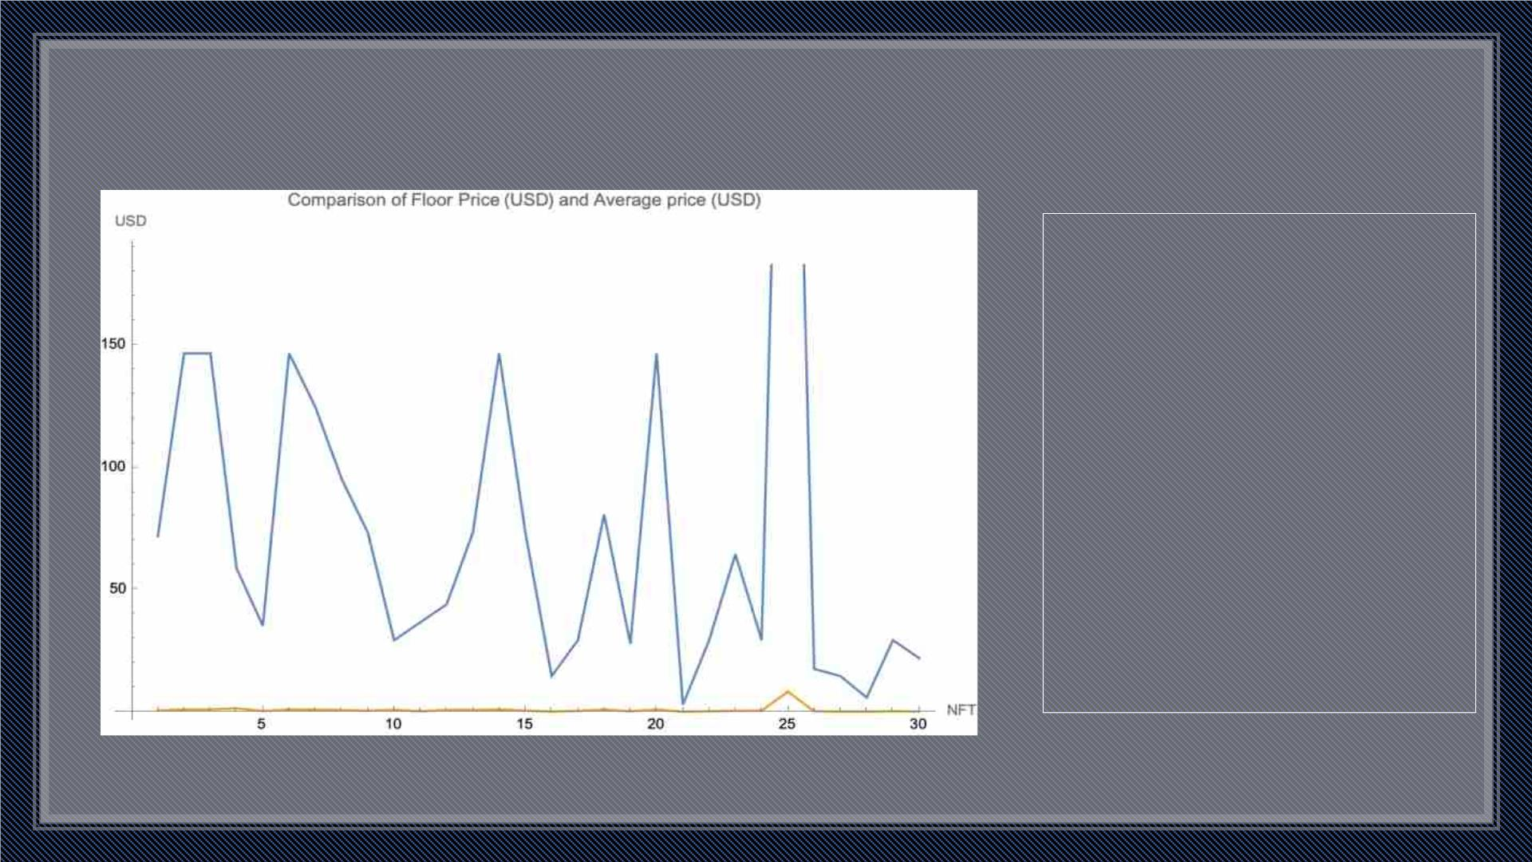
Exclusive NFTs
Hypothesis:
Higher the Owner Asset
Ratio, higher its diversity
(more people own it). So,
lower = exclusive?
Analysis:
Floor Price varies between
$50 and $150 for most of
them. But the average price
is for almost all is less than $1.
Result:
Not exclusive, just a gamble.

Slide 17
Conclusion
• Solana is still a relatively new project, having launched in March 2020. Yet, Solana’s native coin,
SOL, has already climbed among the top 10 Cryptocurrencies by market capitalization. The team
is still working on improving the network’s features and stability and projected to keep growing
• Solana is currently the ‘top dog’ of transaction speeds and cheap gas fees without sacrificing
decentralization.
• We are yet to discover a relationship between token prices of blockchain and prices of NFTs due
to restrictions of data scarcity and research into NFT.
• There are number of factors that controls the value of NFTs such as market demand, buyer
emotion, investment potential and many more.
• From the above exploratory analysis, we can clearly see that “Digital Art” and “Collectibles” are
most appreciated forms of NFT in terms of Market Capitalisation as well as Sales i.e. they cover
more than 75% of the total NFTs.
• Whether NFTs are right investments for the future, and whether the value of NFTs at present is
because of the immutability of the blockchain still remains a dilemma.

Slide 18
Thank You

